Slide 1


NEXT GEN EMPLOYABILITY PROGRAM
CREATING A FUTURE-READY WORKFORCE
Student Name :
Tejas Gaikawad
Student ID :
College Name :
STU64c414be227ae1690571966
Shri Sant Gajanan Maharaj College of engineering

Slide 2
CAPSTONE PROJECT SHOWCASE
Project Title
Exploratory Data Analysis on Space Exploration Missions using Power BI (DA)
Abstract | Problem Statement | Project Overview | Proposed Solution | Technology Used | Modelling & Results | Conclusion | Q&A

Slide 3
Abstract
1
Power BI streamlines the integration and cleansing of diverse datasets crucial for space missions, ensuring data quality and readiness for analysis.
2
Utilizing Power BI's visualization tools, analysts uncover patterns, trends, and anomalies in space mission data, enhancing understanding and identifying areas for further investigation.
3
Power BI's analytical features enable in-depth analysis of mission metrics, including identifying outliers and understanding factors influencing outcomes, such as equipment malfunctions or environmental conditions unique to space.
4
With Power BI, analysts employ predictive modelling and forecasting techniques to anticipate mission parameters, mitigate risks, and optimize decision-making for resource allocation and planning in the challenging domain of space exploration.

Slide 4


Problem Statement
To develop and demonstrate the effectiveness of Power BI as a comprehensive tool for exploratory data analysis on space exploration missions. This involves addressing the challenges of data integration, cleansing, visualization, and predictive modelling specific to space mission datasets, ultimately enhancing decision-making processes and advancing our understanding of space exploration endeavours.

Slide 5

Project Overview
The project aims to showcase the effectiveness of Power BI in enhancing exploratory data analysis (EDA) for space exploration missions.
The project involves leveraging Power BI's capabilities for data integration, cleansing, visualization, and predictive modelling tailored to the unique challenges of space mission datasets.
The analysis encompasses data integration and cleansing, visualization for pattern recognition, descriptive and diagnostic analysis, and predictive modelling for forecasting mission parameters and risks.
The project aims to demonstrate how Power BI can streamline EDA processes, enabling quicker insights extraction, informed decision-making, and improved mission planning and execution.
By showcasing Power BI's efficacy in analysing space mission data, the project contributes to advancing space exploration endeavours, enhancing mission success rates, and fostering scientific discovery in outer space.

Slide 6
Proposed Solution
Importing, Pre-Processing and Data Modelling
Prepare DAX and Dash Board(Visualization)
Advanced Visualization, Filters and Slicers, further Adding various columns and measures to charts to achieve Project requirements
Formatting and Testing the Project Functionality

Slide 7
Technology used
Power BI

Slide 8
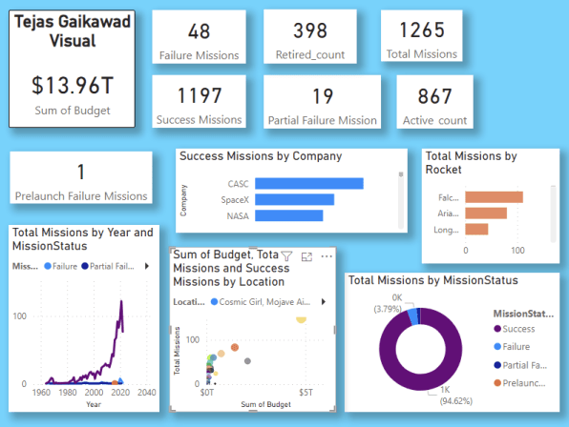
Modelling & Result

Slide 9

Conclusion
The application of Power BI in space exploration data analysis offers a transformative approach to handling the complexities of mission datasets. Through its robust capabilities in data integration, visualization, and predictive modelling, Power BI streamlines processes and enhances decision-making in space missions. The project's findings underscore the importance of leveraging advanced analytical tools to extract valuable insights, optimize resource allocation, and mitigate risks in space exploration endeavours. As we continue to push the boundaries of space exploration, the integration of tools like Power BI will play a pivotal role in unlocking new discoveries and ensuring the success of future missions.

Slide 10


Notes:
Thank You !!

